Slide 1

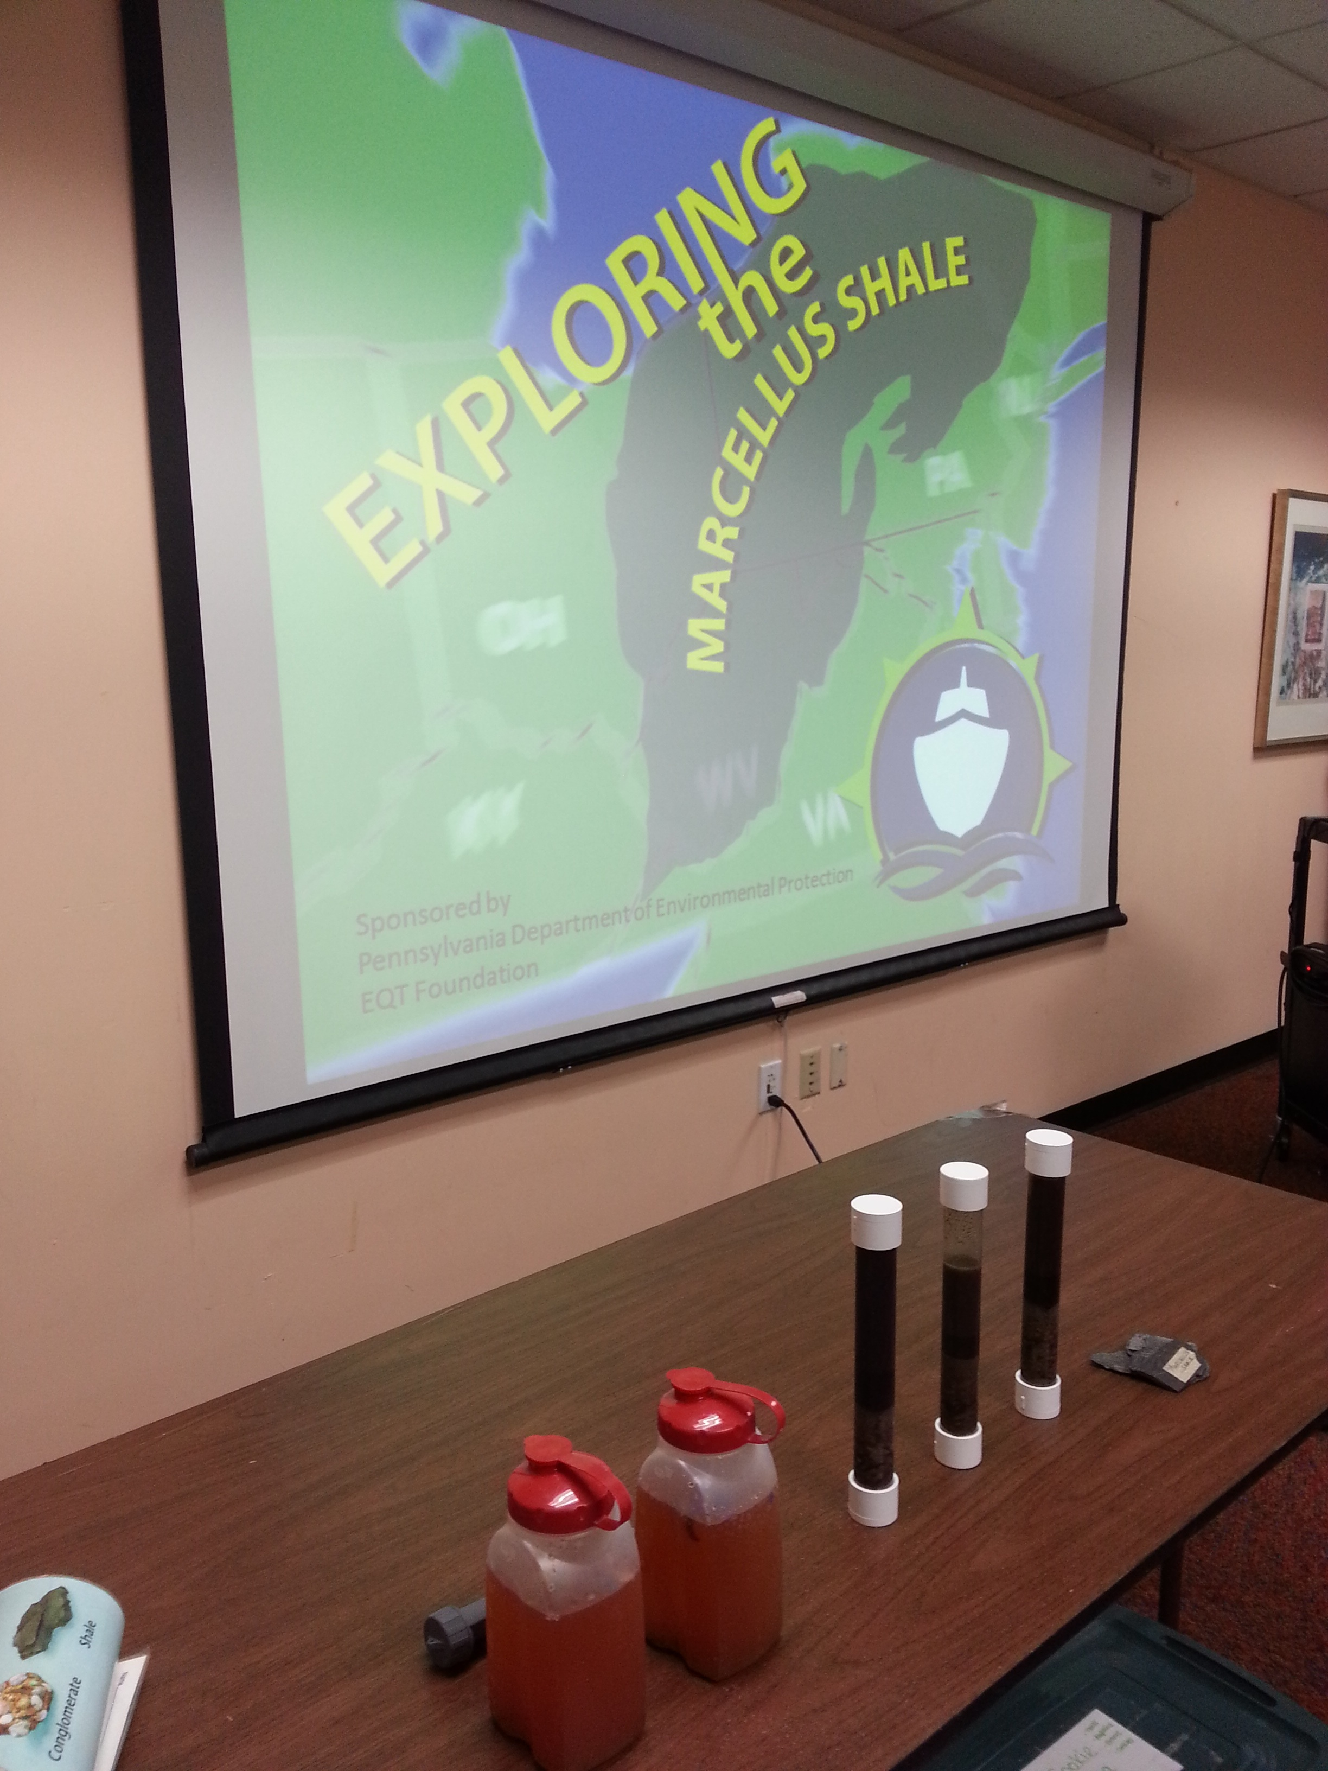
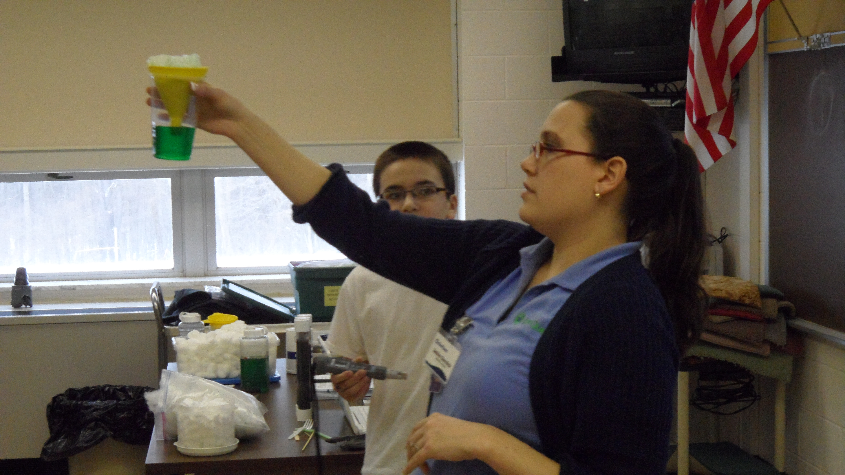
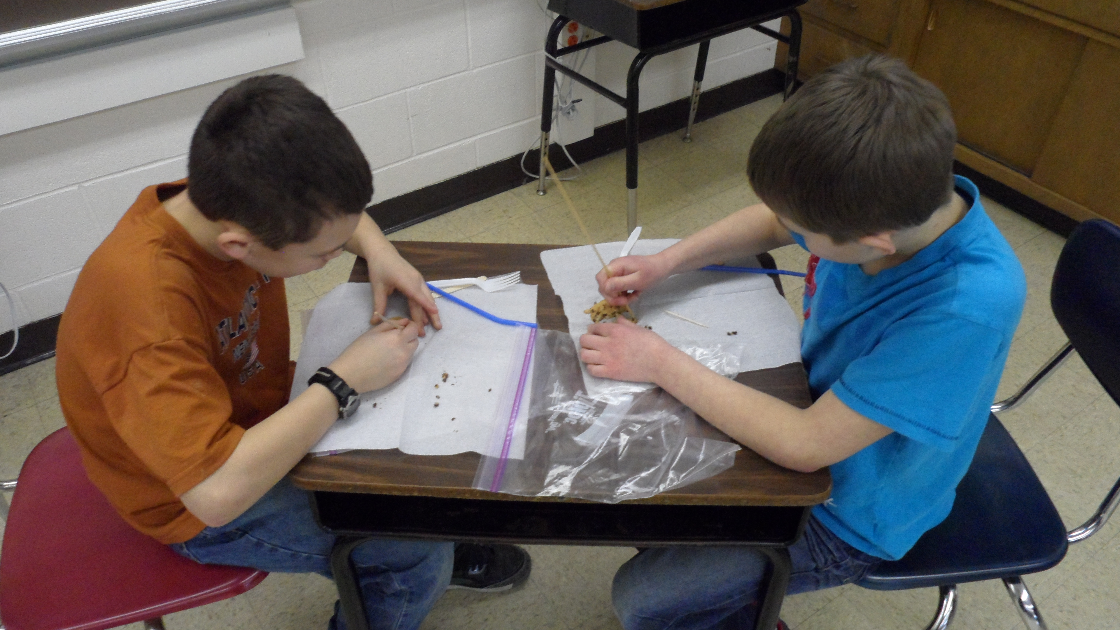
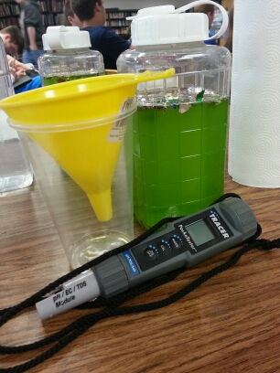
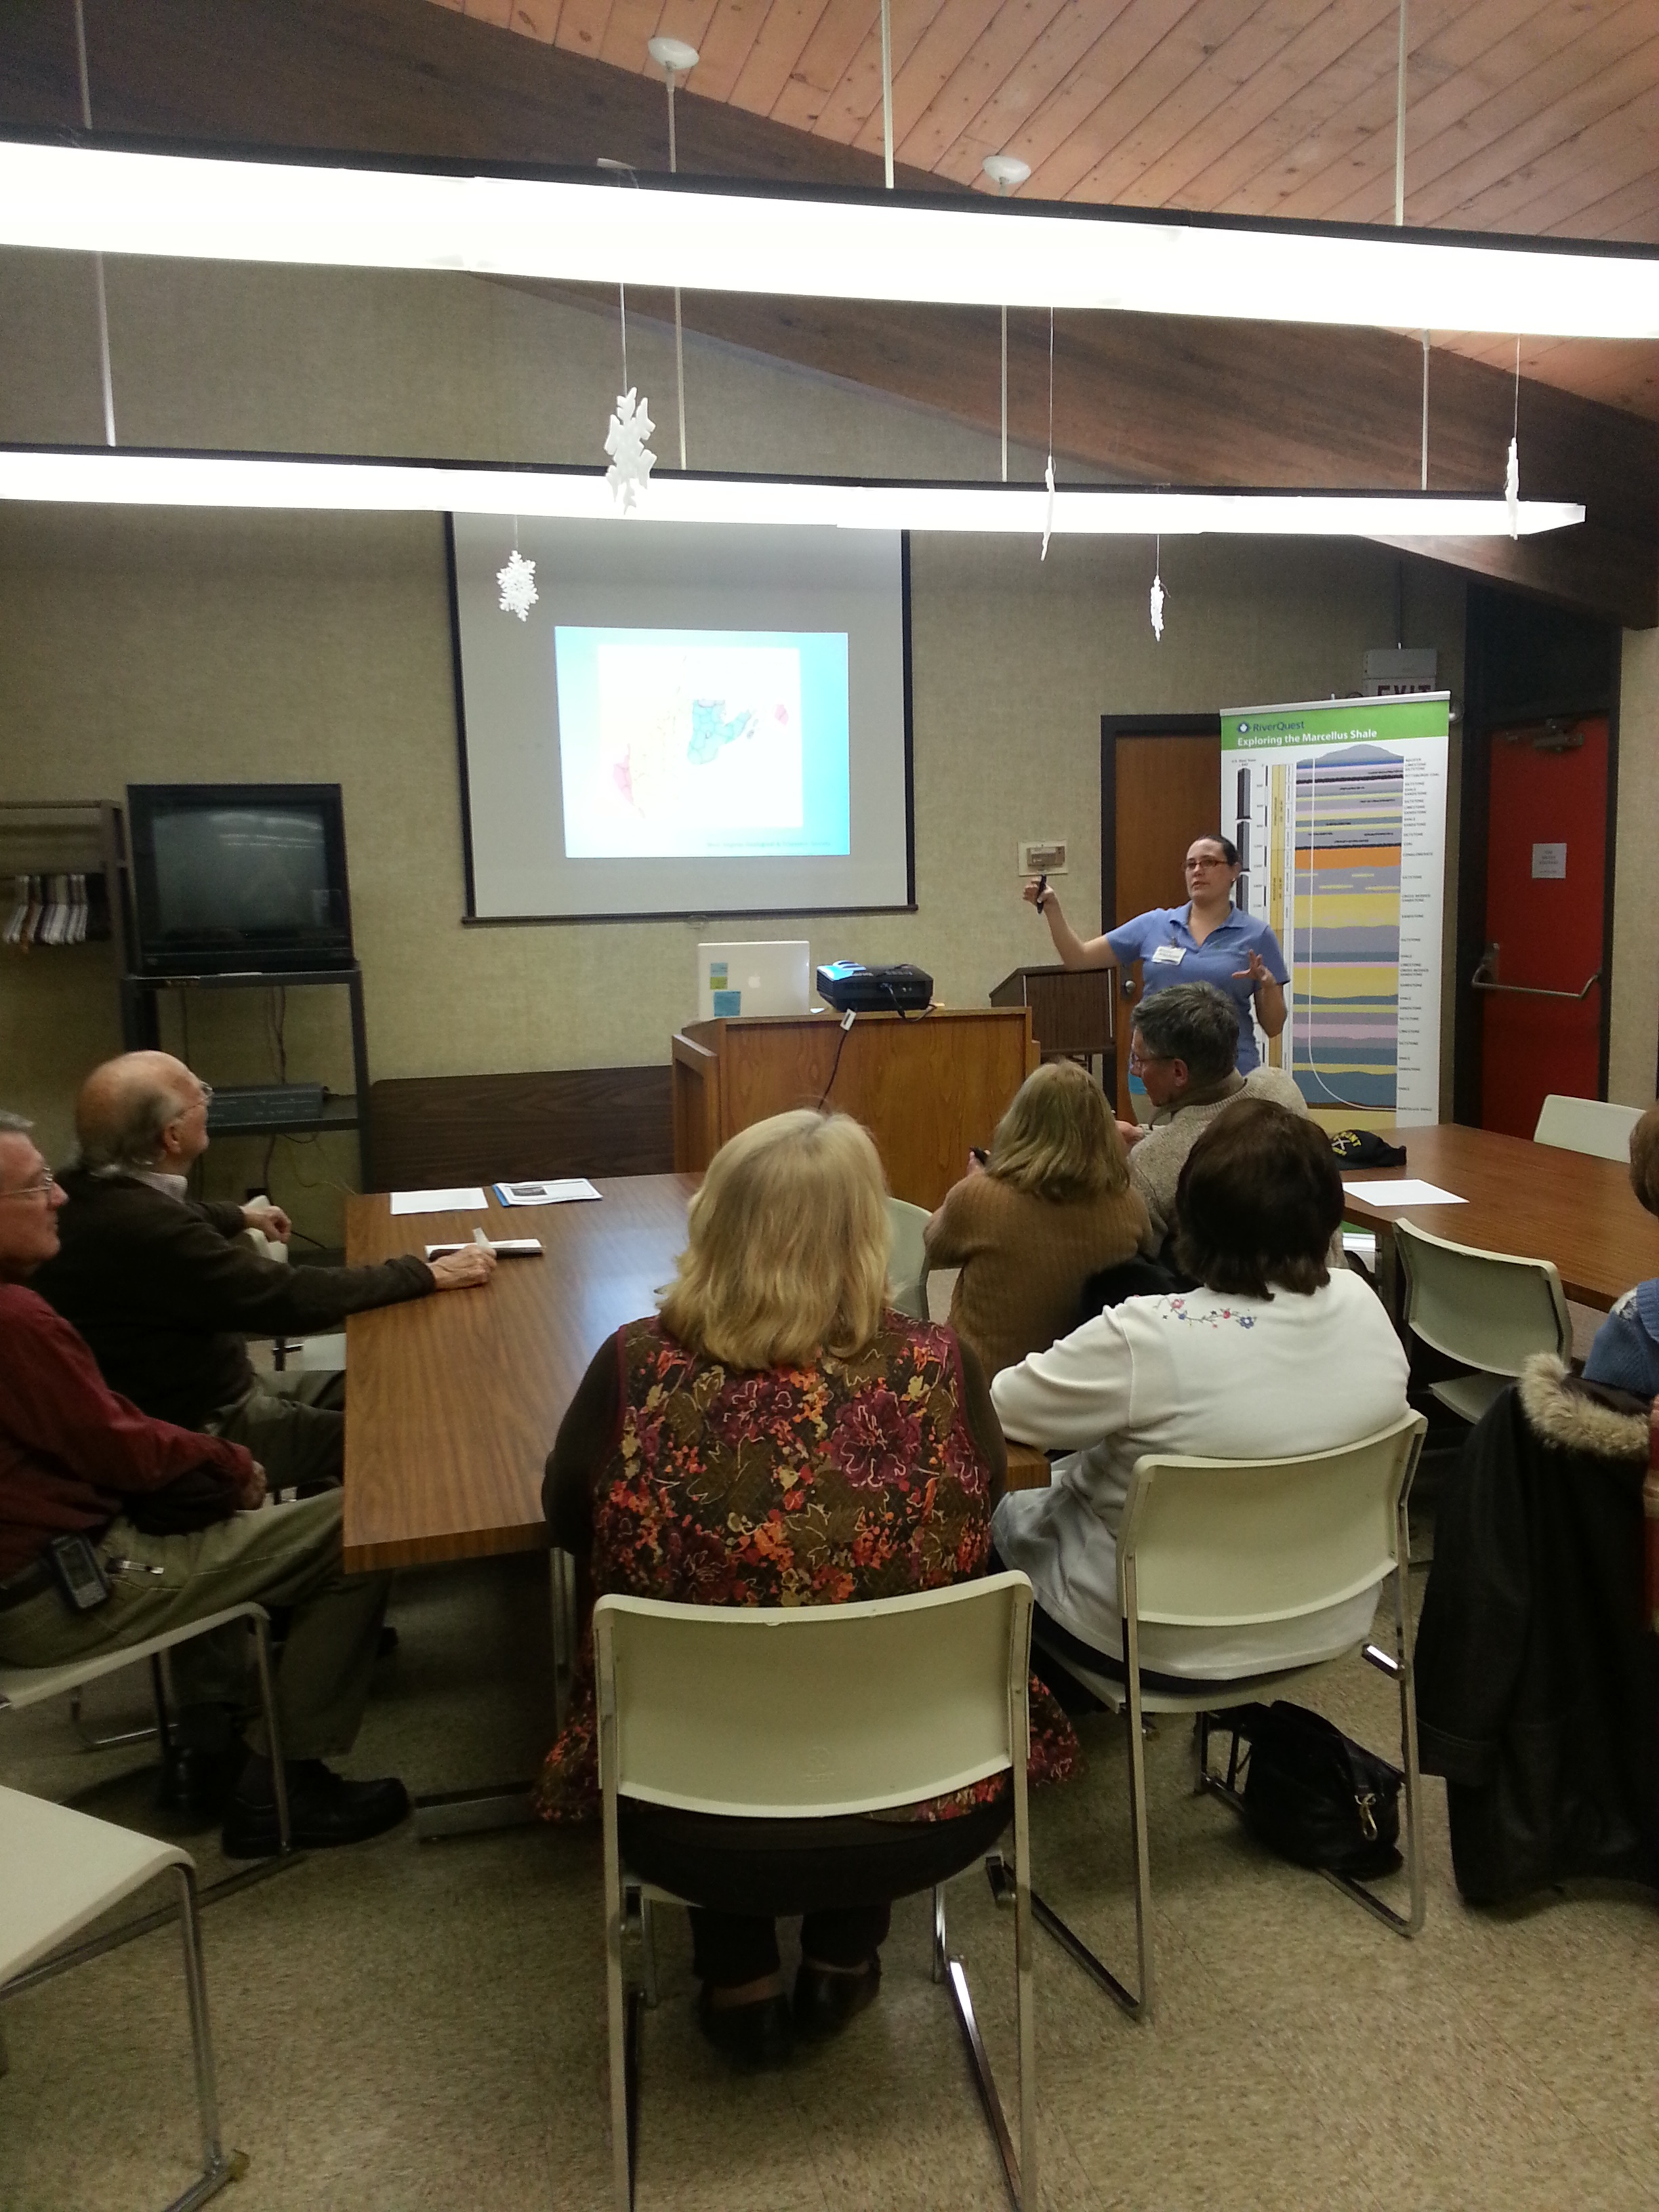
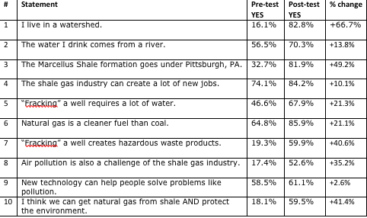
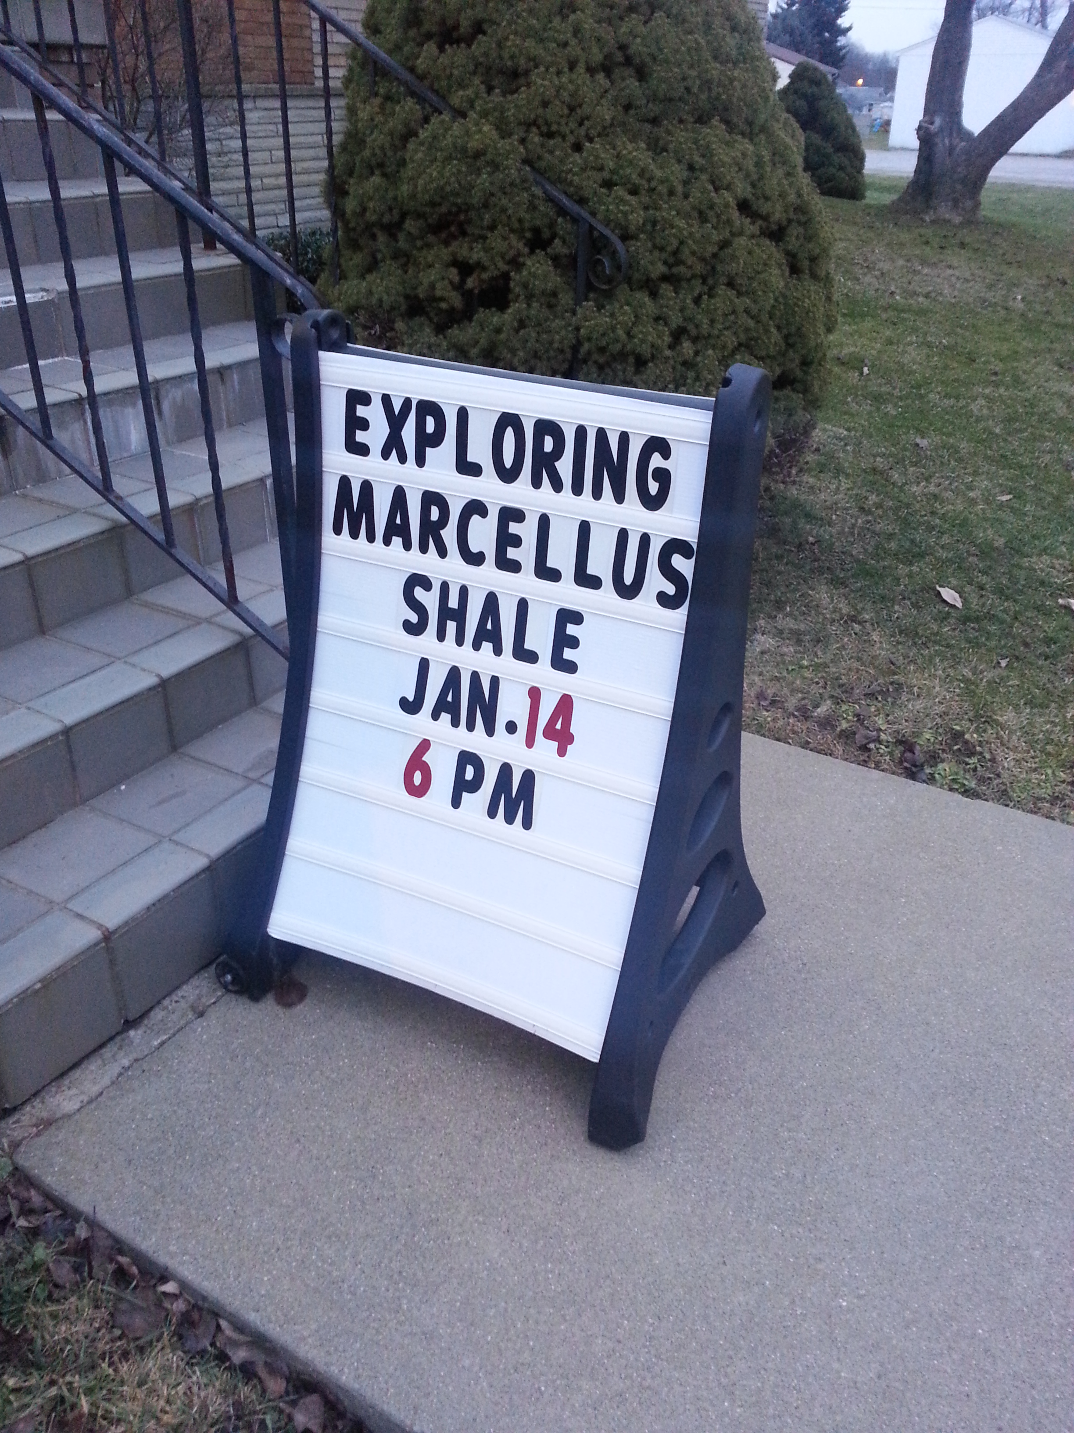
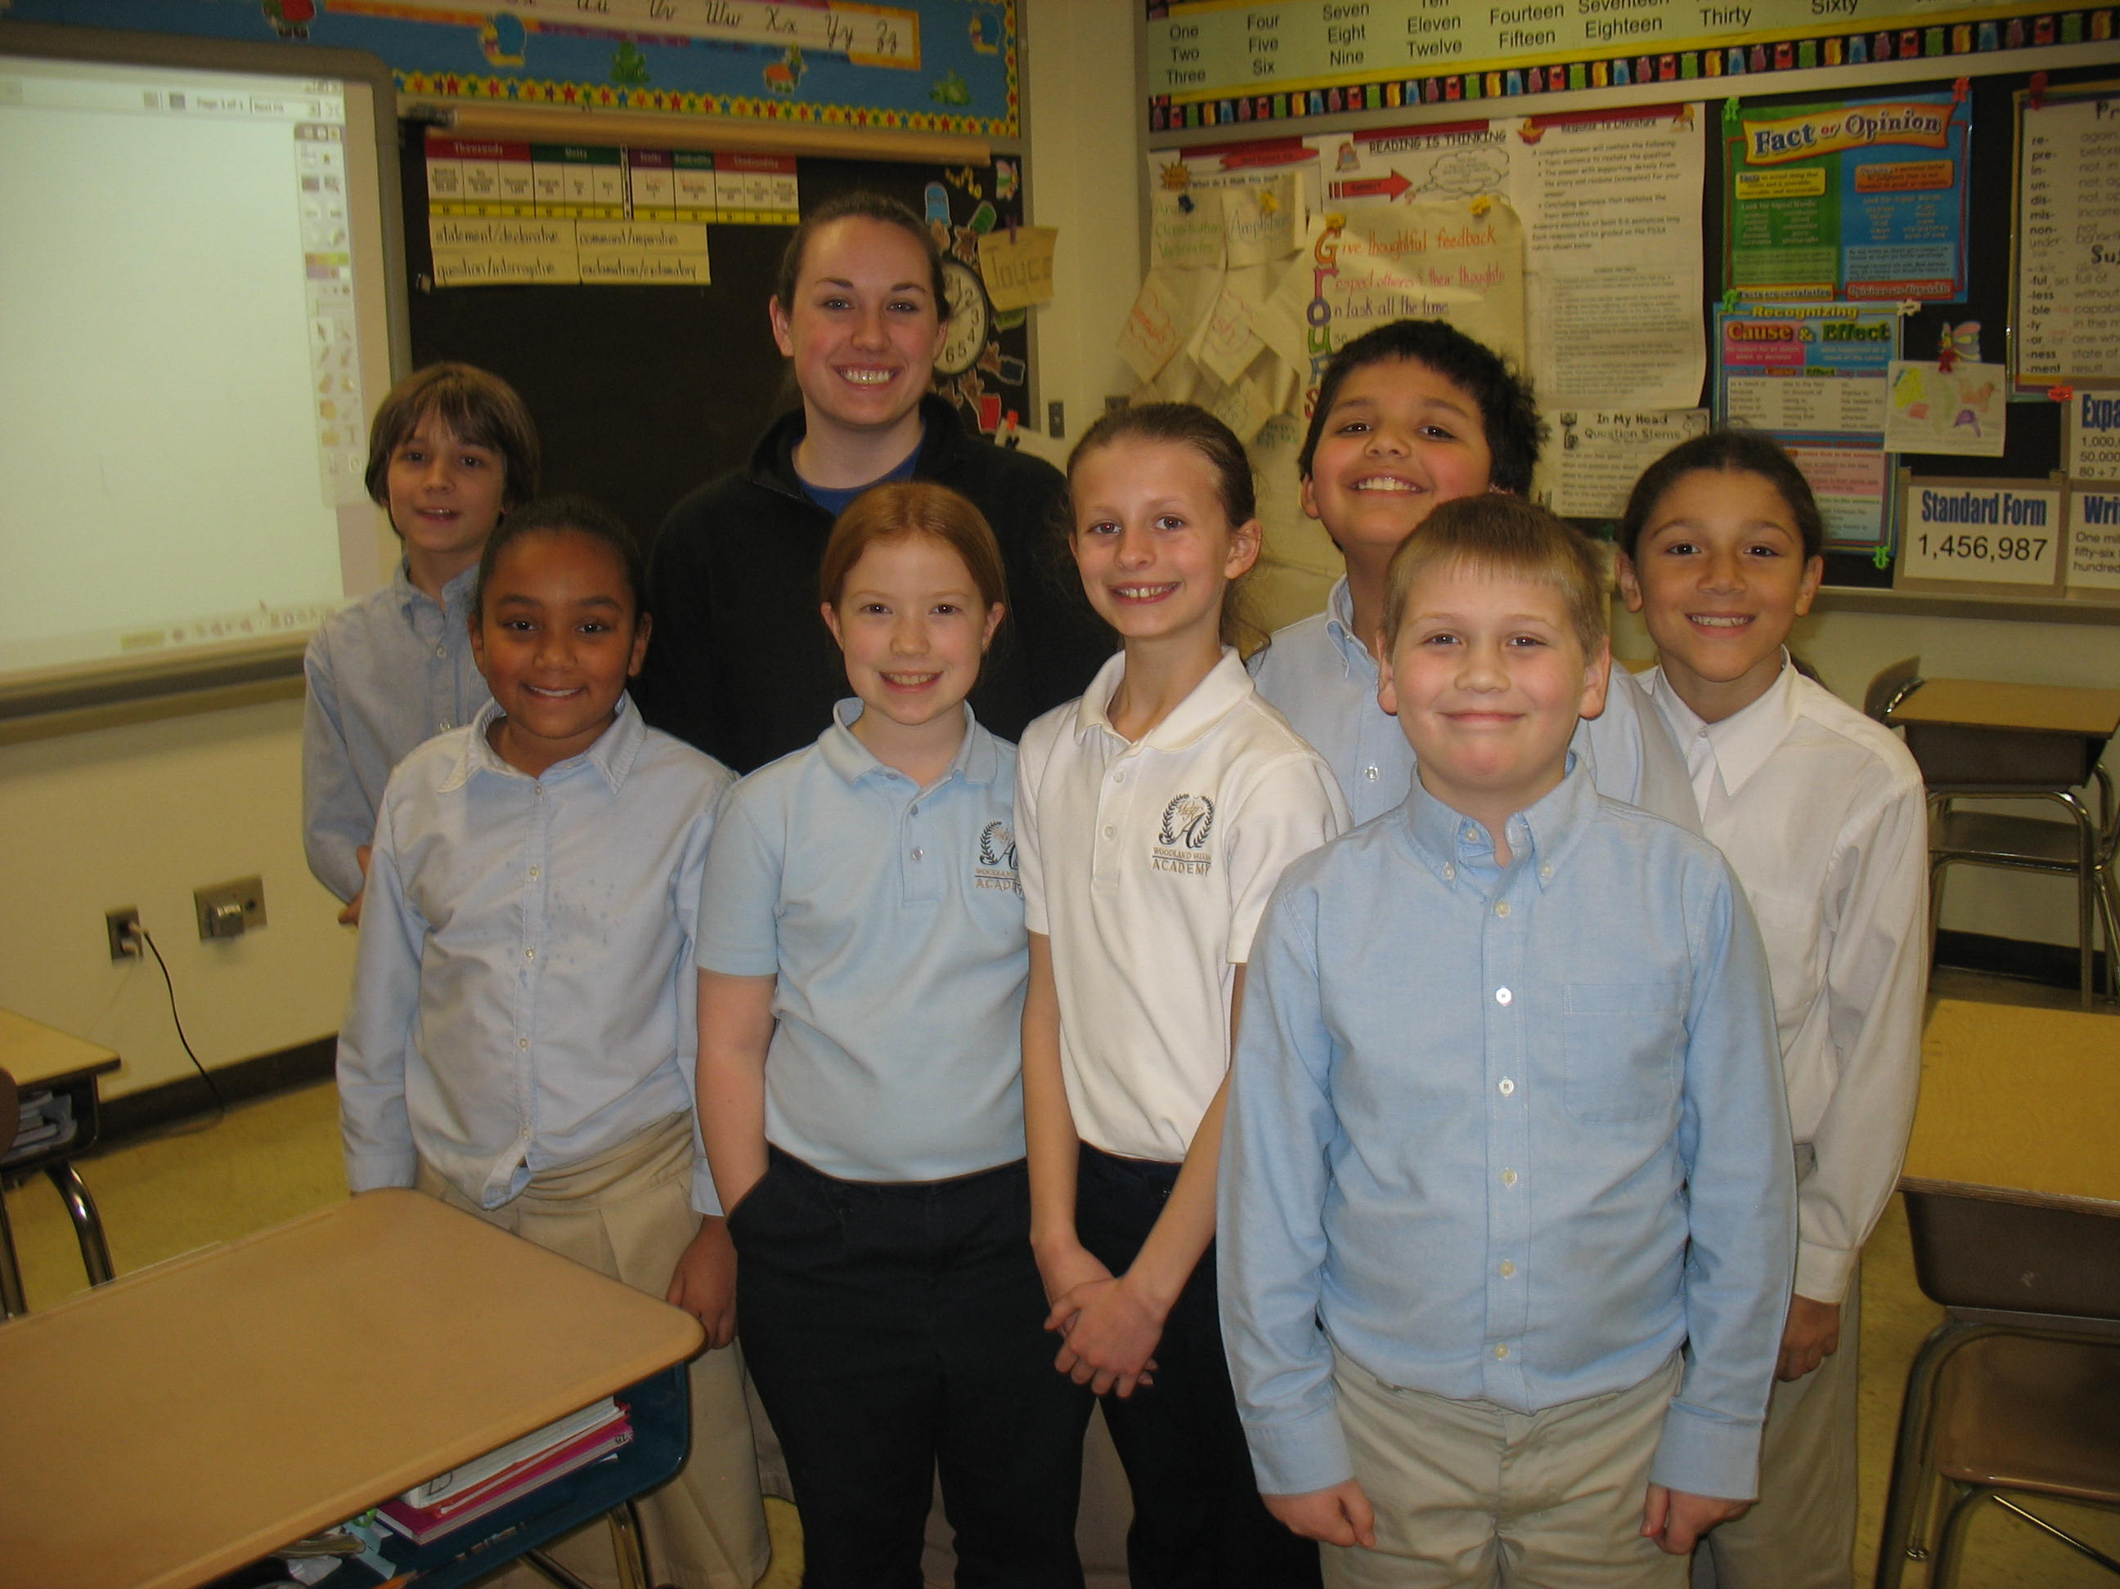
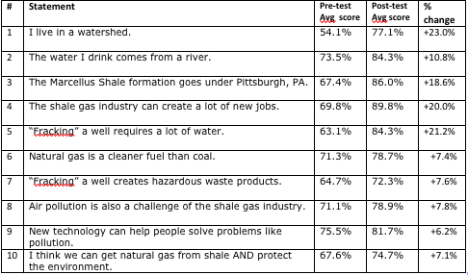

Exploring the Marcellus Shale
Presented by: Janine Surmick and Danielle Stump
Hands-on Focus
Students are encouraged to put their brains to work while they have fun with activities that focus on a few natural resource challenges.
Results
Outreach programming is designed to accommodate a variety of audiences, including school classrooms of students in grades 3-12, student or adult community meetings, and mixed-age groups.
A variety of hands-on activities, images and group discussion are used to help tell the story of the Marcellus Shale, and the basic science behind the process of hydraulic fracturing of shale to extract natural gas. As an informational and educational program, the content gives both the pros and cons of the topic, from the environmental to the economic. The session aims to provide or enhance participants' knowledge of the topic so that they can better understand what they read and hear about Marcellus Shale drilling, and to fashion more informed opinions on the topic.
Academics
This program meets multiple Pennsylvania State Academic Standards in several categories:
4.1 Ecology
4.2 Watersheds and Wetlands
4.3 Natural Resources
4.5 Humans and the Environment
3.3 A. Earth Structures, Processes and Cycles
Pre/Post Test Evaluations
Community Events
Programs are held at libraries and community centers. These events give residents an opportunity to learn about Marcellus shale, ask questions and learn about the resources available.
Recent Recipient:
RiverQuest’s “Exploring the Marcellus Shale” was developed through support from the PA Department of Environmental Protection & EQT Foundation

