Slide 1
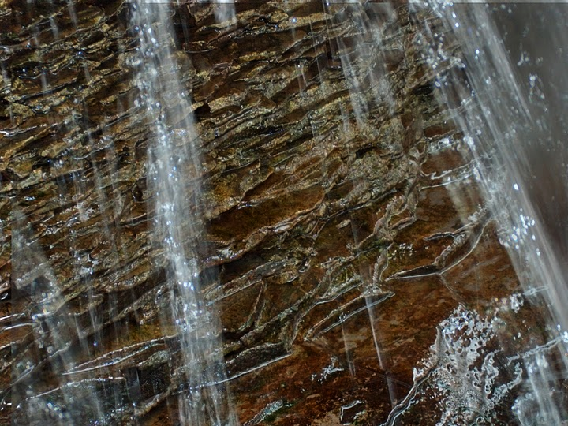
[We need to] “…explore the neighborhood, view the landscape, to discover at least where it is that we have been so startlingly set down, if we can’t learn why.”
Annie Dillard, as quoted by Richard Louv in Last Child in the Woods

Slide 2
Information contained in nature ... allows us a partial reconstruction of the past. ... The development of the meanders in a river, increasing complexity of the Earth's crust ... are information-storing devices in the same manner that genetic systems are. ... Storing information means increasing the complexity of the mechanism.
~ Ramon Margalef as quoted in Meadows, 2008

Slide 3
Why does this place look the way it does?
Don Duggan-Haas, Sara Auer Perry, Christine Besemer Whitaker, Richard Kissel & Robert Ross
PRI & its Museum of the Earth
NSTA 2011

Slide 4
Creating Virtual Fieldwork Experiences as Professional Development
Don Duggan-Haas, Sara Auer Perry, Christine Besemer Whitaker, Richard Kissel & Robert Ross
PRI & its Museum of the Earth
NSTA 2011

Slide 5
A Template for Virtual Fieldwork Creation
Don Duggan-Haas, Sara Auer Perry, Christine Besemer Whitaker, Richard Kissel & Robert Ross
PRI & its Museum of the Earth
NSTA 2011

Slide 6
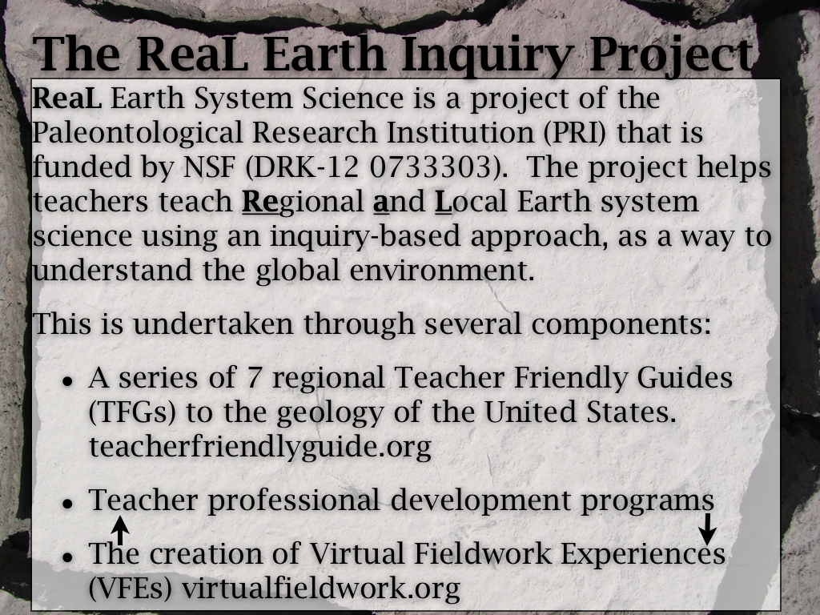
The ReaL Earth Inquiry Project

Slide 7
Structure of the session
Show some Virtual Fieldwork Experiences (VFEs)
Unfortunately, no Internet, so no Google Earth…
Show some tools for making VFEs.
VFE development as professional development.

Slide 8
Like a cooking show…
I’ve got some stuff that I’ve already made, and I’ll show you the ingredients and how they’re put together.

Slide 9
Pre-assessment questions:
How many have uploaded pictures to Flickr, Picasa, Photobucket or other photosharing sites?
Google Earth Experience?
None?
I’ve found my house.
I’ve made a few tours.
More than a few tours, but not an expert…
I’m an expert creator of Google Earth content.

Slide 10
Pre-assessment questions:
PowerPoint Proficiency:
I don’t use it.
I use it, but I don’t do anything beyond adding text and pictures.
I do things with PowerPoint that go beyond the above.

Slide 11
What is virtual fieldwork?
Let’s take a look at a couple of examples. We won’t have time for all of these…
Crater Lake
Chicago’s 57th St. Beach
Milwaukee Shoreline
Como Lake Park
In PowerPoint
In Google Earth (not today…)

Slide 12
Structure of the PD
Homework to start…
Face-to-face 2.5 day workshop.
Begin work on a VFE of the workshop site.
Introduce pedagogical and technological approach
TPACK-focused
Continue for a year afterward online study groups, sharing…
Completion of workshop site VFE
Creation of VFE local to teachers’ schools

Slide 13
Did we…
Look at some VFEs?
Talk about VFE development as professional development (and mention this year’s programming?)
Look at some tools for VFE development?

Slide 14
Questions?

Slide 15
"The moment one gives close attention to any thing, even a blade of grass it becomes a mysterious, awesome, indescribably magnificent world in itself."
- Henry Miller

Slide 16
Why Como Lake Park?
To reinforce other work we’re doing, I wanted to find accessible Marcellus Shale outcrops.
I used the USGS New York State Geologic Map in Google Earth to find exposures.
http://tin.er.usgs.gov/geology/state/
I searched within Google Earth for “Marcellus” after downloading the geologic map, found the formation and looked for accessible places near my home.
We also want to add more urban and suburban settings that are likely to be similar to what teachers have outside their classroom doors.

Slide 17
Two kinds of Picasa…
Picasa is both software for managing photos on your computer, and,
A photo sharing web site, very much like flickr
Both are Google products.

