Slide 1
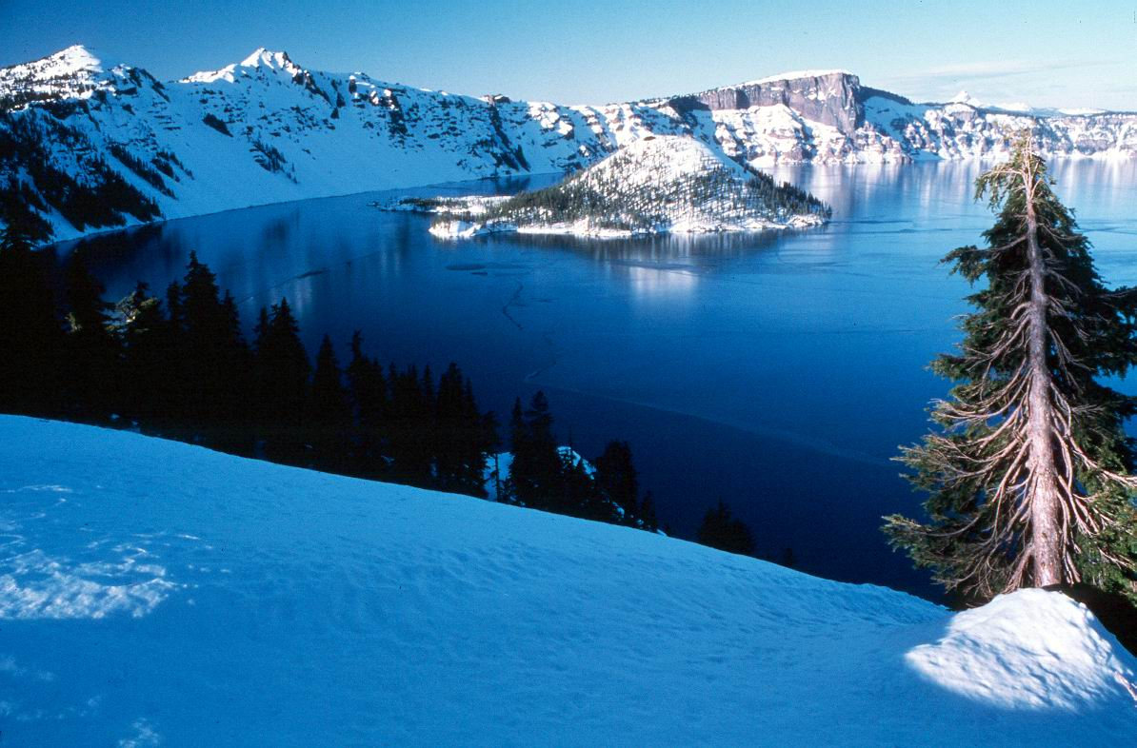
Why is the water so blue?

Slide 2
1. Water molecules are blue
2. Water reflects the blue sky.

Slide 3
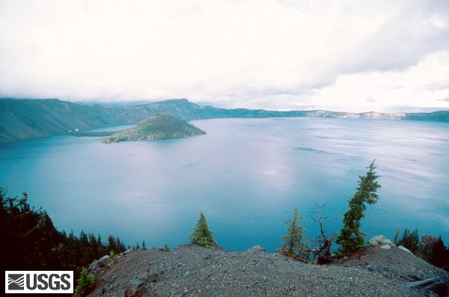
NO- the sky is white, but the water is still blue

Slide 4
Water really is blue. Why?

Slide 5
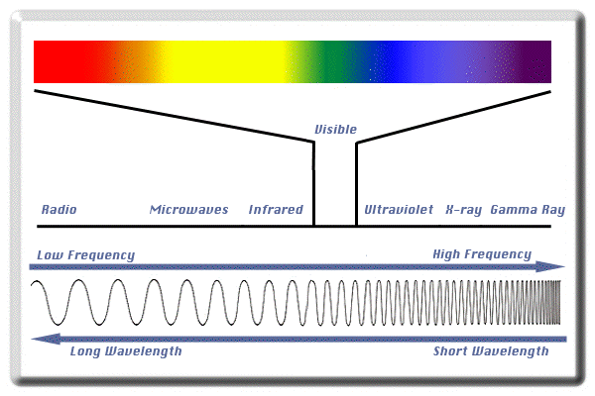
Water absorbs longer wavelenghts
What visible wavelength is most likely to be absorbed?
RED
BLUE

Slide 6
Correct- red is absorbed first

Slide 7
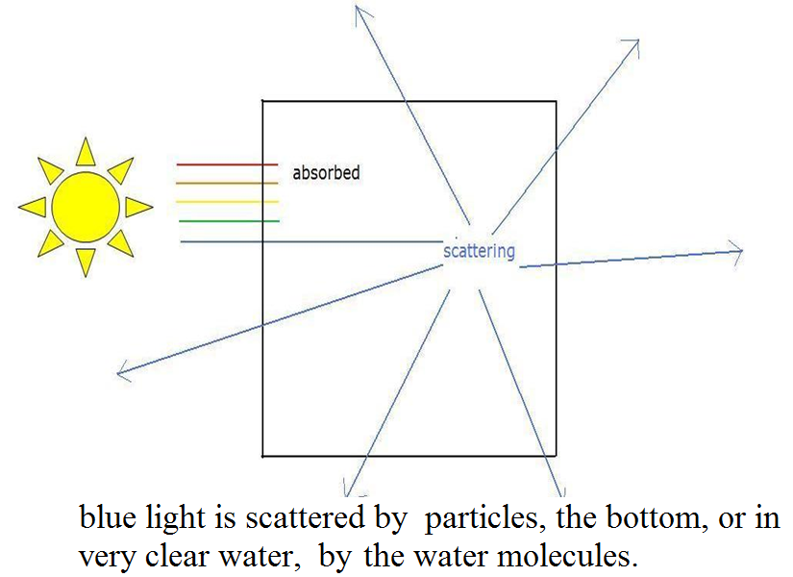

Slide 8
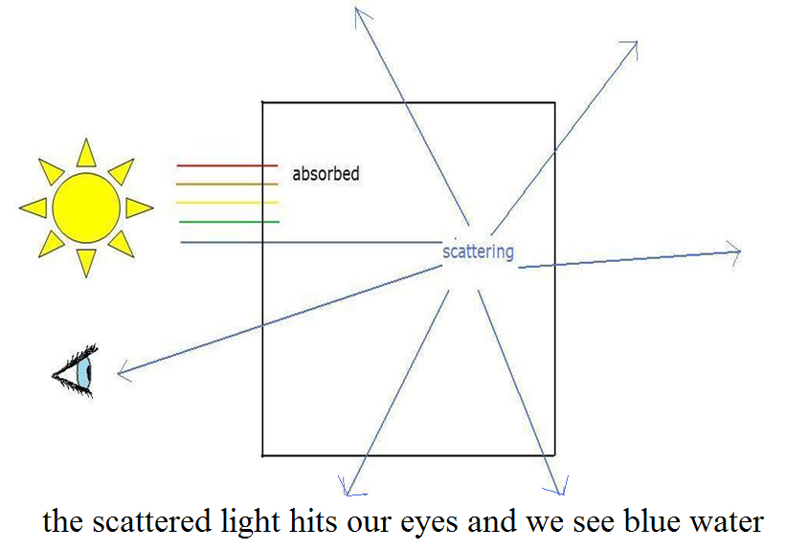

Slide 9
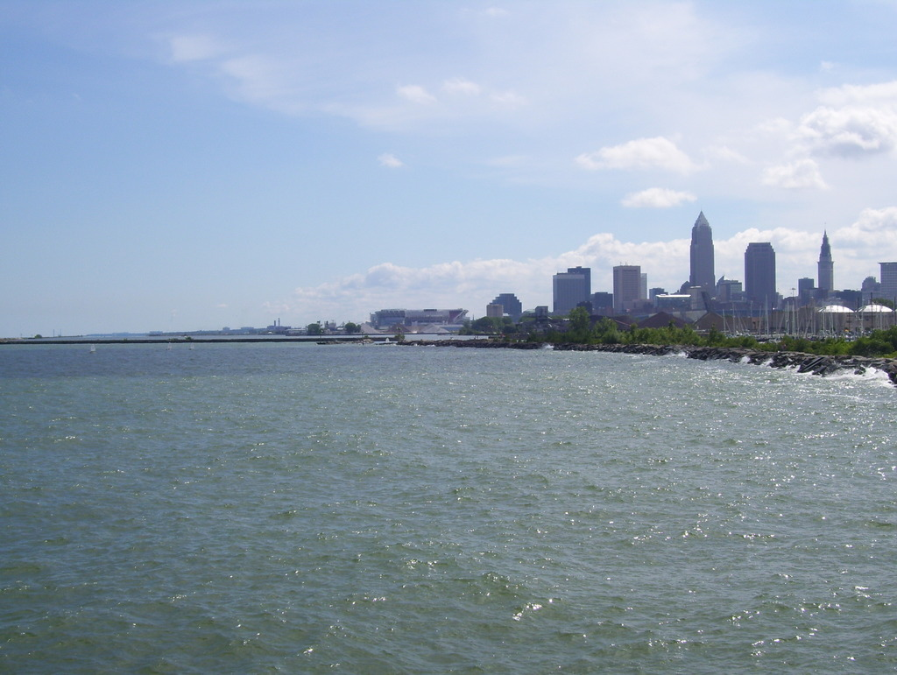
Why is it SO blue?
Much more blue than Lake Erie

Slide 11
Which leads to the next obvious question…..

Slide 12
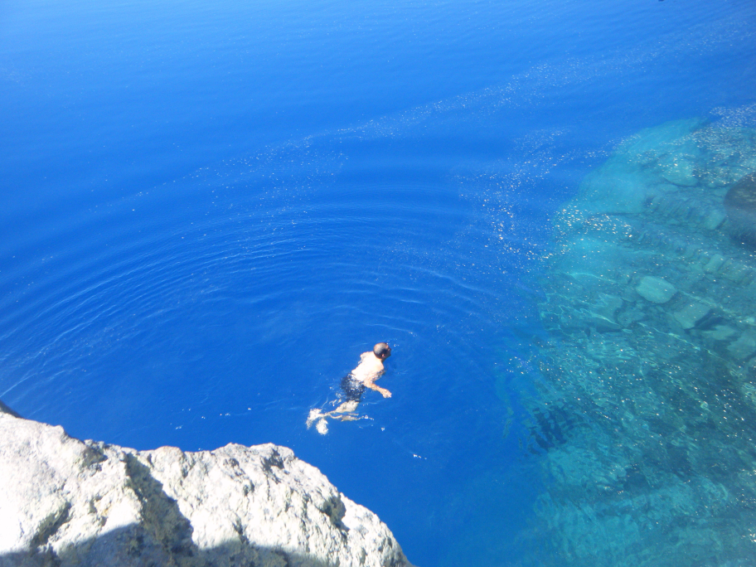
Why is the water so clear?

Slide 13
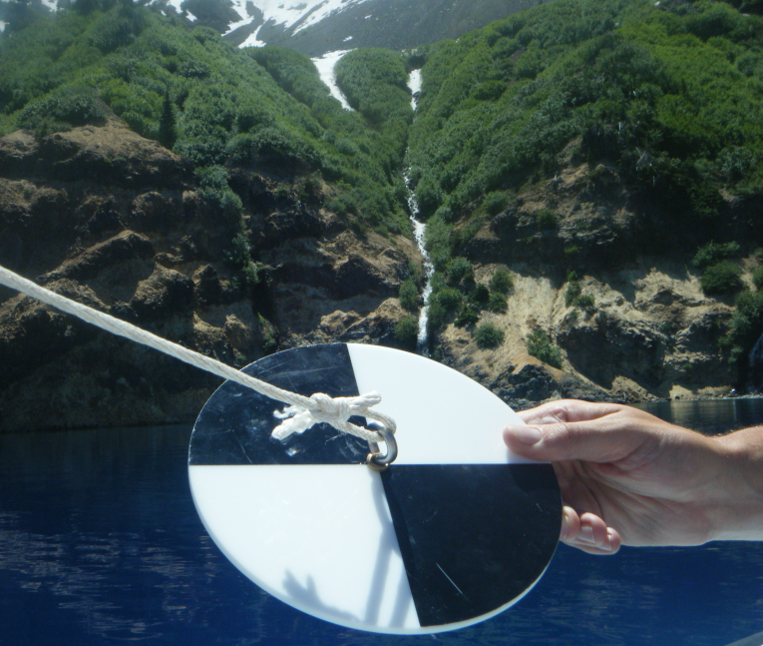
We measure clarity with a Secchi Disk

Slide 14
Link to Youtube

Slide 15
Video was of a Secchi disk lowered a few feet into a Missouri Lake
In Crater Lake, the Secchi disk was lowered

Slide 16
134 ft. (40.8 m)
Average between 90-100 ft.
The clearest lake in the world!

Slide 17
How does sediment get into lakes?
Air and Water
Name at least
one natural
one human-generated particle that could reach the lake by air

Slide 18
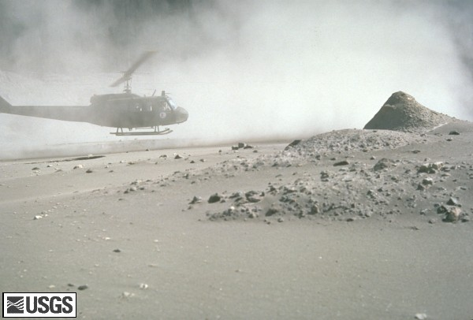
Natural
Volcanic ash, pollen, wildfire ash
Man-made (anthropogenic)
Particulates from combustion (smog)

Slide 19
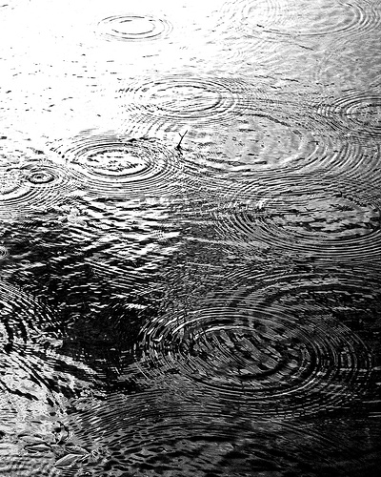
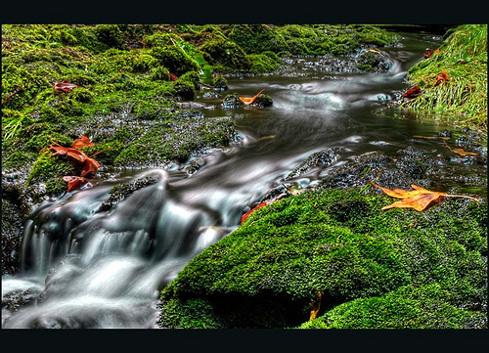
How does water get into a lake?
Rain
Streams draining the land

Slide 20
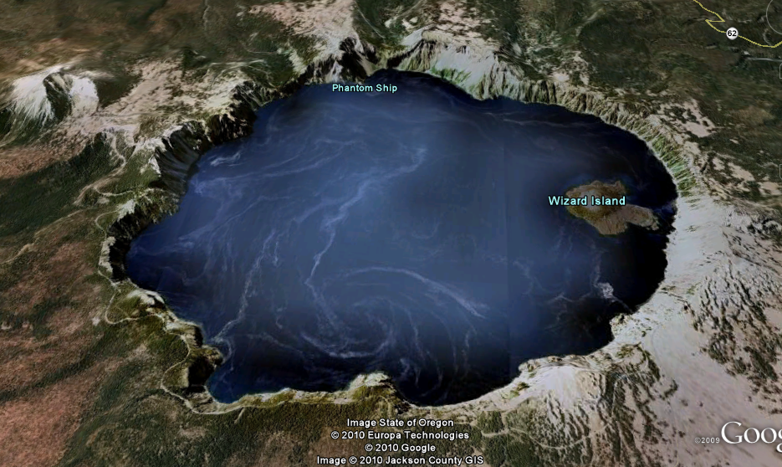
Does Crater Lake have streams?

Slide 21
Where are they?
Click here

Slide 22
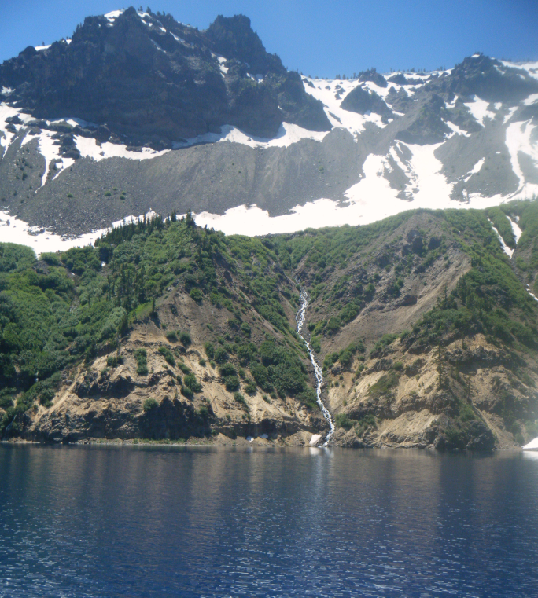
That is it, a tiny stream
Why so few streams?

Slide 23
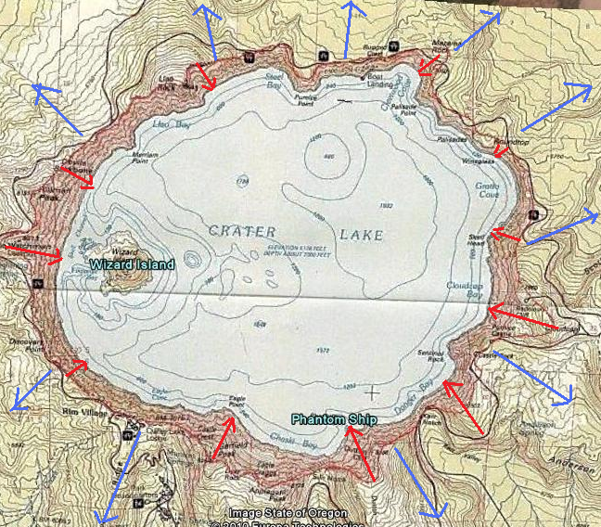
Water flows downhill
Crater Lake is on the top of a mountain

Slide 24
Drainage Basin
The area that drains into a lake is its drainage basin or watershed.
What are the boundaries of the Crater Lake Drainage basin?
Notes:
Crater Lake is much larger than its drainage basin.

Slide 25
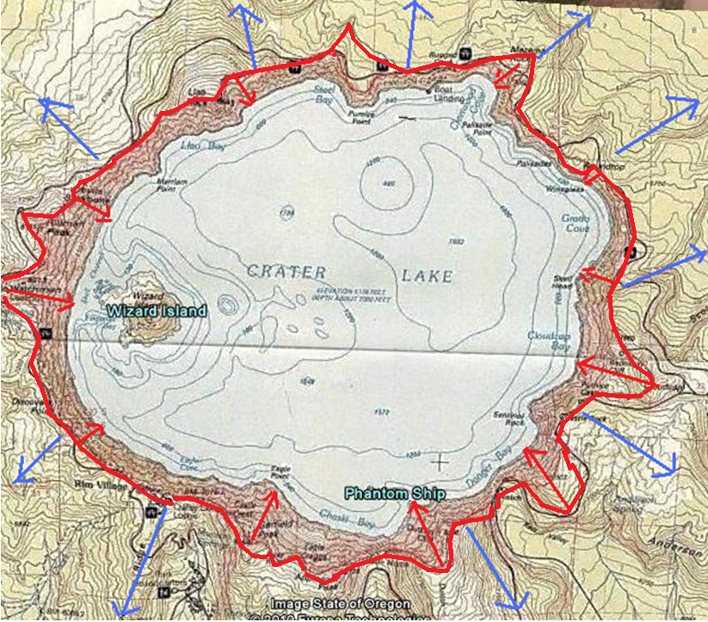
The red line is the boundary, also known as the drainage divide

Slide 26
What % of the rain that falls into the Crater Lake drainage basin falls directly into the lake?
1. 78%
2. 52%
3. 26%
4. 5%
5. 1%

Slide 27
No…try again

Slide 28
Correct!
78% of the water that enters Crater Lake is pure rainwater!
No wonder its is so clear
Streams carry sediment

Slide 29
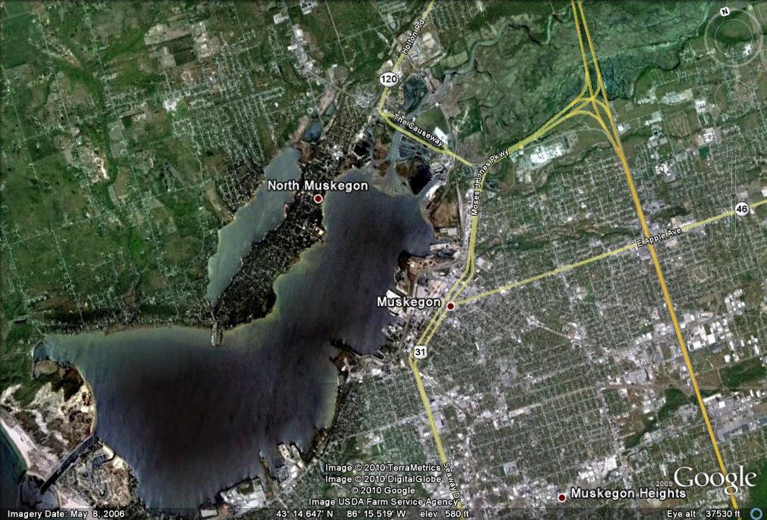
Muskegon Lake
Secchi Disk disappears after only 2 meters
(6 ft)
Would you expect Muskegon Lake to have a large watershed?
Yes
No

Slide 30
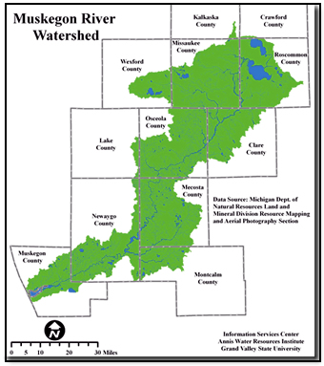
It is huge!
Muskegon Lake
More than 99% of the water that enters the lake is brought by Muskegon River
(<1% as rain)

Slide 31
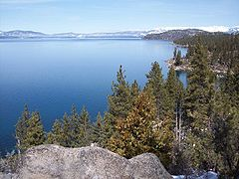
Lake Tahoe
Lake Tahoe is the clearest lake in California
Typical Secchi Disk measurements = 70ft.
What % of the water that enters Lake Tahoe enters the lake directly as rain?
80%
50%
20%
5%
Notes:
Lake Tahoe drains a larger area than Crater Lake. Larger basins will result in more sediment entering the lake. So the smaller the drainage basin, the less sediment, and the clearer water.

Slide 32
No- try again

Slide 33
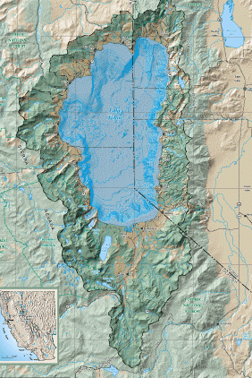
Correct

Slide 34
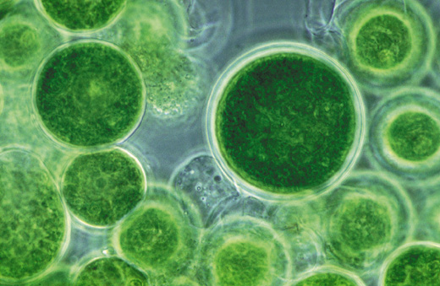
Why is there so little algae in Crater Lake?

Slide 35
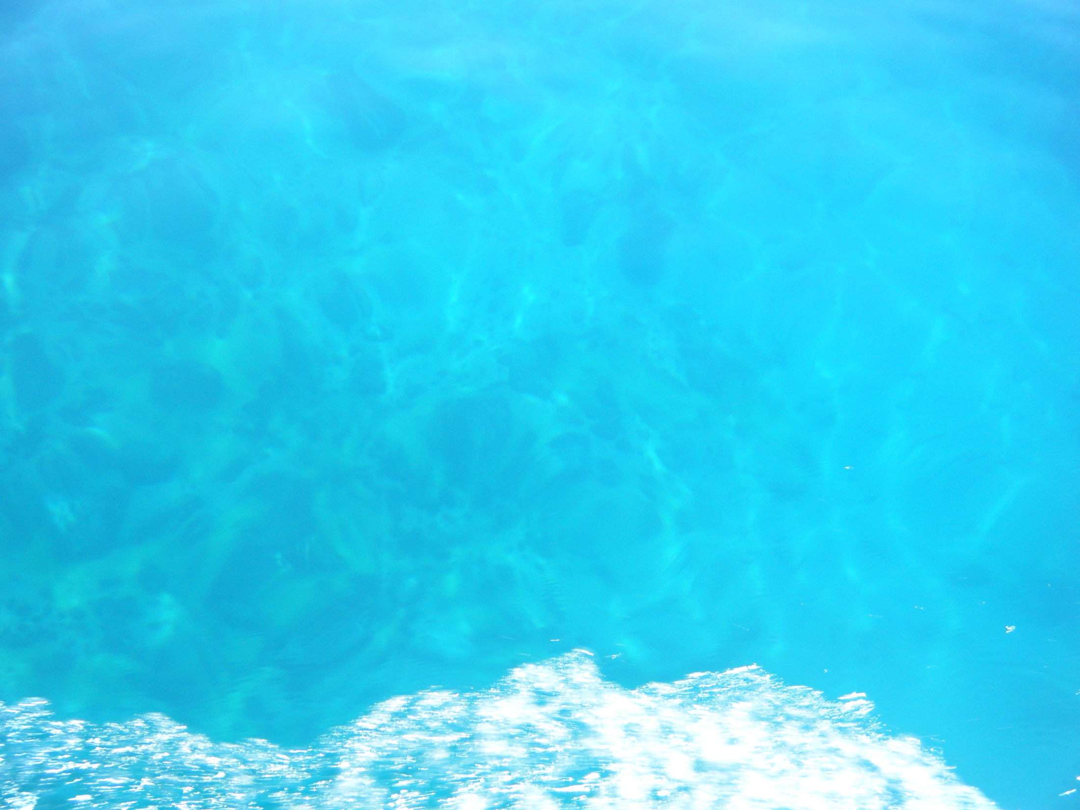
No sediment
No nutrients (nitrates and phosphates)
No algae
Clear water !

Slide 36
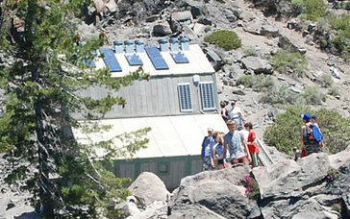
What is this building?
It is located near the water.
1. Water gaging station
2. Ecology Study Center
3. outhouse

Slide 37
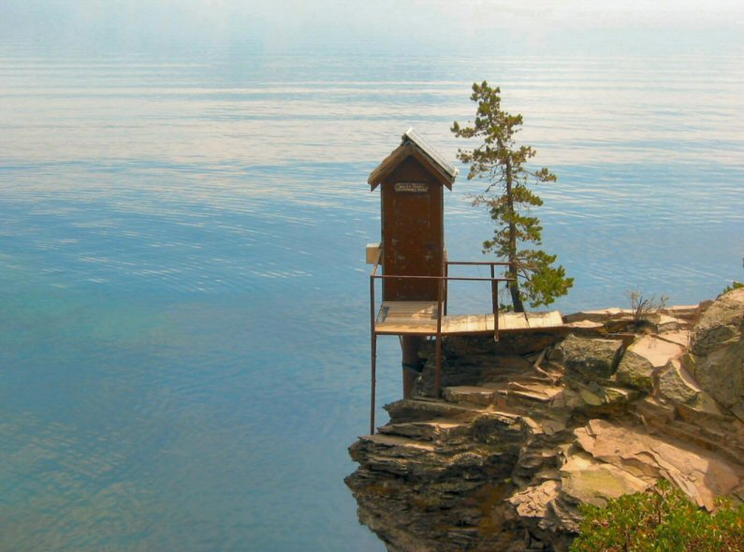
Try again
This is the water gaging station
Aren’t you glad it isn’t the outhouse?

Slide 38
No
Hint- the building looks a lot better than it smells.

Slide 39
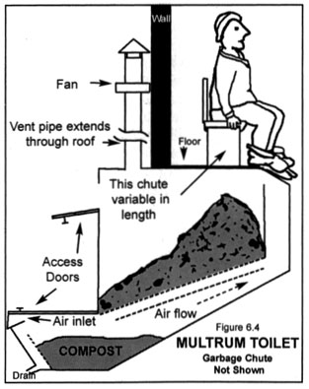
Correct
This is a composting outhouse
Human waste is turned into compost and hauled out of the watershed
No waste to provide nutrients for algae

Slide 40
little stream sediment, no human waste
So what is this stuff floating on the lake?

Slide 41
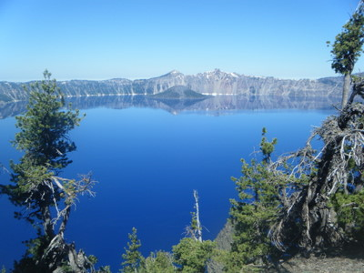
Hint

Slide 42
Yes, it is tree pollen
So in summary
Beautiful blue water
Deepest lake in North America
Clearest water in the world

Slide 43
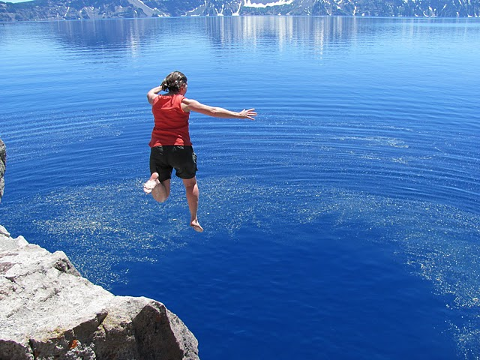
and hard to resist on a hot day!

