Slide 1
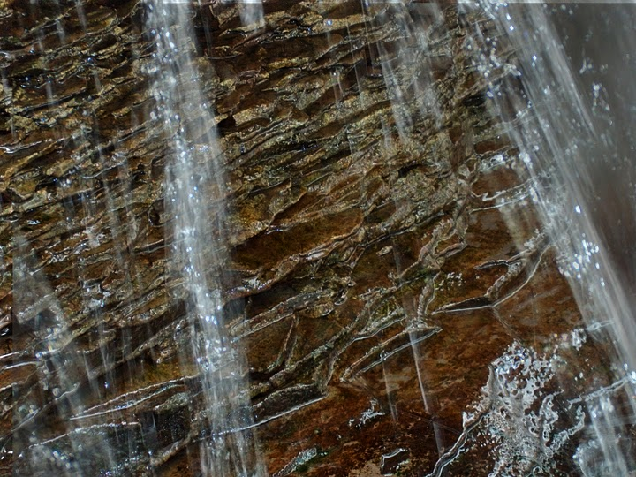
[We need to] “…explore the neighborhood, view the landscape, to discover at least where it is that we have been so startlingly set down, if we can’t learn why.”
Annie Dillard, as quoted by Richard Louv in Last Child in the Woods

Slide 2
A Template for Virtual Fieldwork Creation
Don Duggan-Haas, Sara Auer Perry, Christine Besemer, Richard Kissel & Robert Ross
PRI & its Museum of the Earth
STANYS 2010

Slide 3
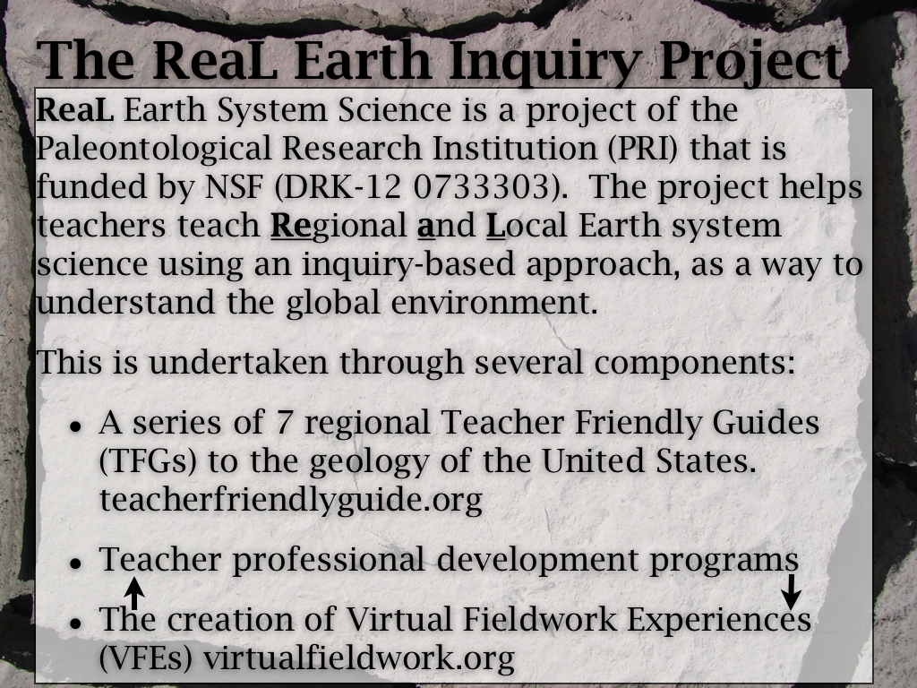
The ReaL Earth Inquiry Project

Slide 4
Structure of the double session
The first hour will primarily be an overview of virtual fieldwork, with some opportunity to explore sprinkled in.
The second hour will primarily be time to work with support from us and occasional demonstrations sprinkled in.
The workshop is intended to build in niftiness over time.

Slide 5
Like a cooking show…
I’ve got some stuff that I’ve already made, and I’ll show you the ingredients and how they’re put together.

Slide 6
Pre-assessment questions:
How many of you brought computers to this session?
How many have uploaded pictures to Flickr, Picasa, Photobucket or other photosharing sites?
Google Earth Experience?
None?
I’ve found my house.
I’ve made a few tours.
I’m an expert creator of Google Earth content.

Slide 7
Pre-assessment questions:
PowerPoint Proficiency:
I don’t use it.
I use it, but I don’t do anything beyond adding text and pictures.
I do things with PowerPoint that go beyond the above.

Slide 8
Two kinds of Picasa…
Picasa is both software for managing photos on your computer, and,
A photo sharing web site, very much like flickr
Both are Google products.

Slide 9
What is virtual fieldwork?
Let’s take a look at a couple of examples.
Como Lake Park
In PowerPoint
In Google Earth

Slide 10
Why Como Lake Park?
To reinforce other work we’re doing, I wanted to find accessible Marcellus Shale outcrops.
I used the USGS New York State Geologic Map in Google Earth to find exposures.
http://tin.er.usgs.gov/geology/state/
I searched within Google Earth for “Marcellus” after downloading the geologic map, found the formation and looked for accessible places near my home.
We also want to add more urban and suburban settings that are likely to be similar to what teachers have outside their classroom doors.

Slide 11
Did we…
Show both PowerPoint & Google Earth
Show internal linking in PowerPoint
Profiles in Google Earth
New York Geologic map in Google Earth
Resources page at virtualfieldwork.org

Slide 12
"The moment one gives close attention to any thing, even a blade of grass it becomes a mysterious, awesome, indescribably magnificent world in itself."
- Henry Miller

